Slide 1

Java Arrays

Slide 2
Agenda
What is an Array?
Declaring and Assigning an array
Array Length
Array editing
Multidimensional Arrays

Slide 3
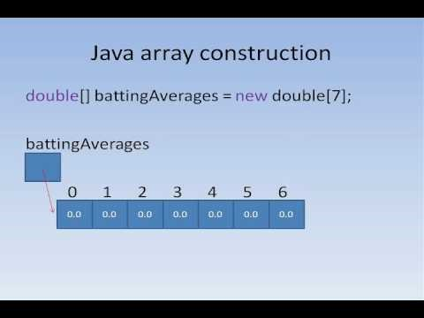

Slide 4
What is an Array?
An array is a container object that holds a fixed number of values of a single type. - Oracle
An array is a structure which can store multiple values of the same data type. This prevents the need to declare separate variables for each value.
String name1;
String name2;
String name 3;
String[] names;

Slide 5
Characteristics of an Array
An array has two distinguishing characteristics:
Length (i.e., the number of variables (AKA components) it stores) The length of an array cannot be changed (i.e., it is fixed upon creation).
Homogeneity (i.e., every variable in an array has the same data type).

